Slide 1
lEADINg case study
Group Members:
Konidena Rupadithya Sadha Sai
Mohd Aijazuddin
Nishigandha Londhe

Slide 2
Problem Statement
X Education sells online courses to industry professionals.
X Education gets a lot of leads, its lead conversion rate is very poor. For example, if, say, they acquire 100 leads in a day, only about 30 of them are converted.
To make this process more efficient, the company wishes to identify the most potential leads, also known as ‘Hot Leads’.
If they successfully identify this set of leads, the lead conversion rate should go up as the sales team will now be focusing more on communicating with the potential leads rather than making calls to everyone.
Business Objective:
X education wants to know most promising leads.
For that they want to build a Model which identifies the hot leads.
Deployment of the model for the future use.

Slide 3
The following methodology is followed to solve the objective:
Data cleaning and data manipulation.
Check and handle duplicate data.
Check and handle NA values and missing values.
Drop columns, if it contains large amount of missing values and not useful for the analysis.
Imputation of the values, if necessary.
Check and handle outliers in data.
EDA
Univariate data analysis: value count, distribution of variable etc.
Bivariate data analysis: correlation coefficients and pattern between the variables etc.
Feature Scaling & Dummy Variables and encoding of the data.
Classification technique: logistic regression used for the model making and prediction.
Validation of the model.
Model presentation.
Conclusions

Slide 4
Data Manipulation:
The data is verified for missing values and null values. Based on the review assessment these missing values are treated by deleting the columns and imputing with other values or varibles in the categorical columns.
Also unwanted columns are identified as per the statement and removed from the analysis.
Exploratory Data Analysis:
Univariate and Bivariate analysis is performed to understand the data and identify the major columns with respect to the Business problem.
Outliers are identified for the numerical variables and treated them accordingly.
The details are as follows.

Slide 5
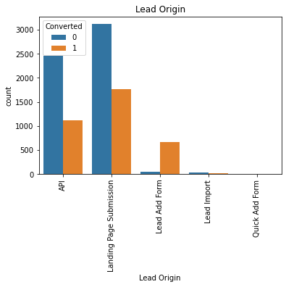
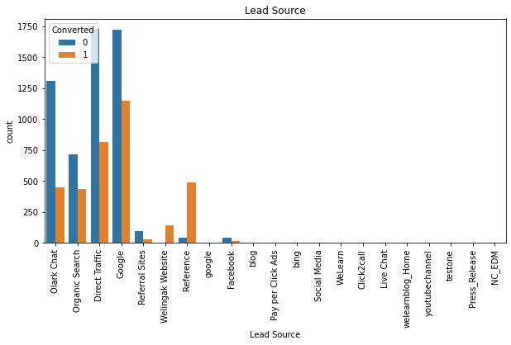

Slide 6
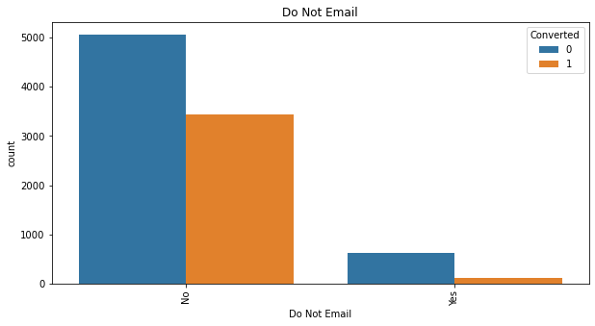
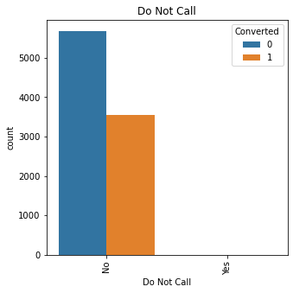

Slide 7
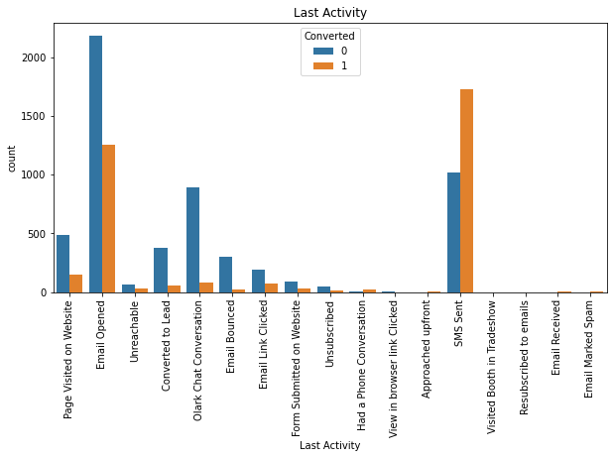

Slide 8
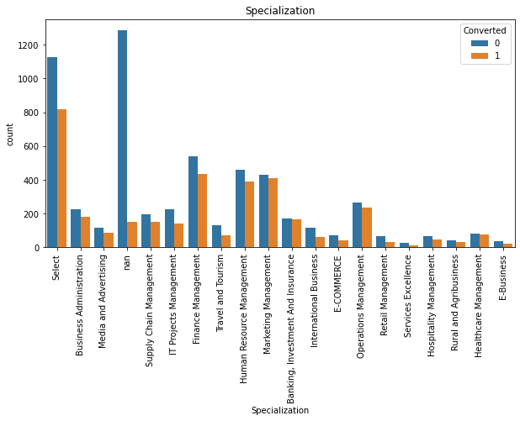

Slide 9
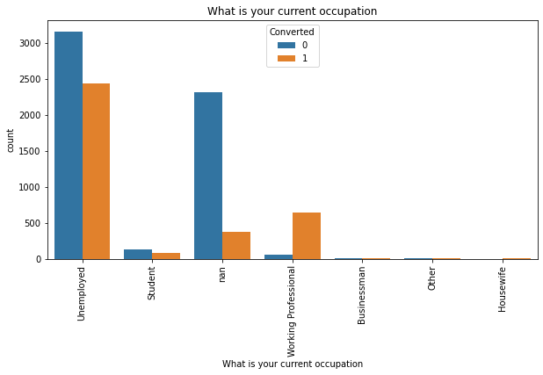

Slide 10
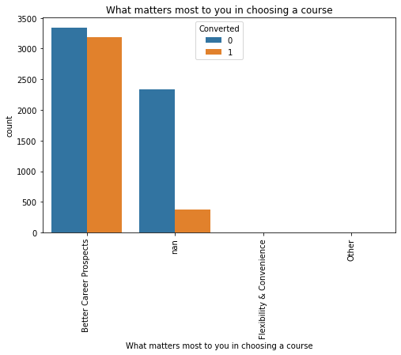
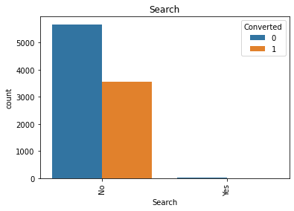
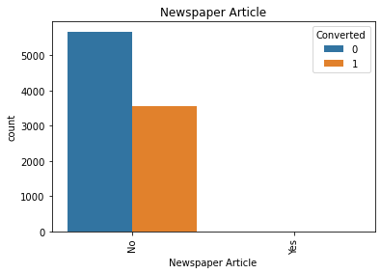

Slide 11
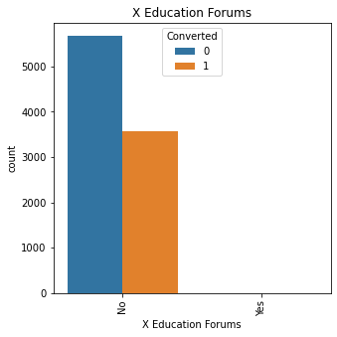



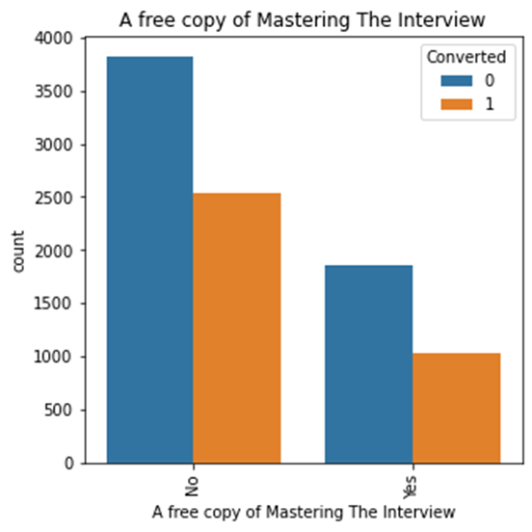

Slide 12
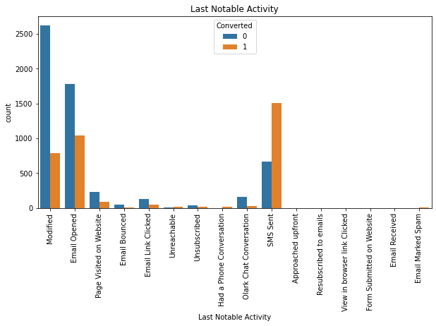

Slide 13
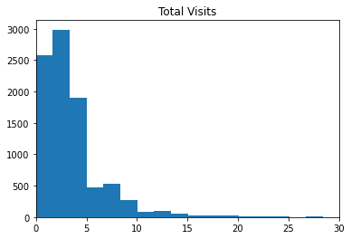
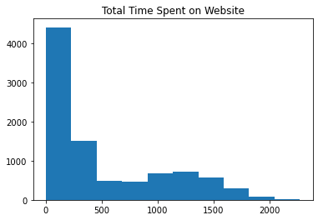
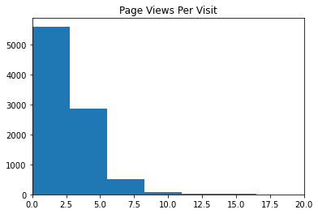

Slide 14
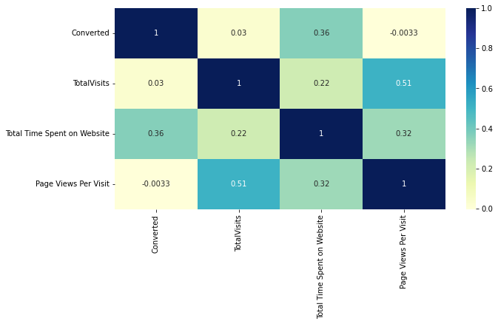
Correlation between numerical variables are as below:
It is understandable from the above EDA that data is less relevance to our analysis. Total time spent on website and converted is having a high relation compared to others

Slide 15
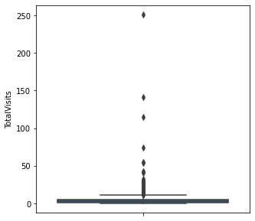
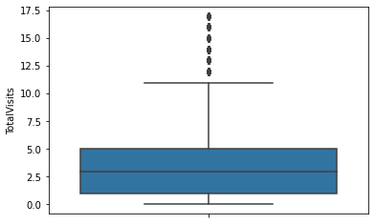
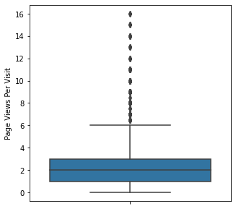
Outliers:
Page Views Per Visit is having the outliers and considered 99 percentile.

Slide 16
Model Building
Splitting the Data into Training and Testing Sets
The first basic step for regression is performing a train-test split, we have chosen 70:30 ratio.
Use RFE for Feature Selection
Running RFE with 15 variables as output
Building Model by removing the variable whose p- value is greater than 0.05 and vif value is greater than 5
Predictions on test data set
Overall accuracy 81%

Slide 17
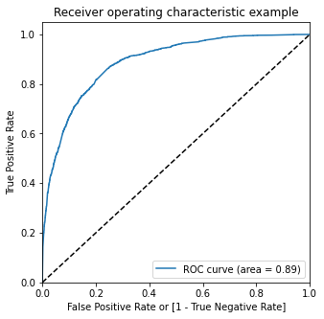
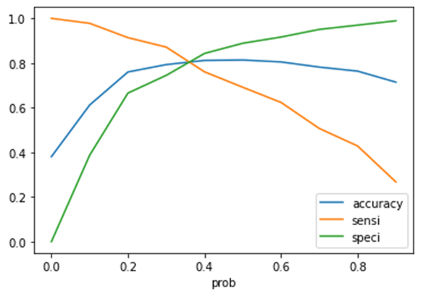
ROC Curve and Cut Off
The obtained AUC value is 89% and optimal cut off is at 0.35.

Slide 18
Conclusion:
Based on the built model, the following variables are to be considered most in order to have a very high chance to get almost all the potential buyers to change their mind and buy their courses. total time spend on the Website, Lead Source_Google, Lead Source_Direct Traffic, Lead Origin_Lead Add Form, Last activity_sms sent, what is your current occupation, Lead Source_Welingak Website, Lead Source_Organic Search, What is your current occupation_Working Profes, Last Activity_Olark Chat Conversation, Do Not Email_Yes, Lead Source_Referral Sites, Last Activity_Had a Phone Conversation, Last Notable Activity_Unreachable.

